Slide 1

The Column Analysis by Allie Wicklund

Slide 2
Table of Contents
Introduction
Exploring the Language
Weekday Analysis
Click Counts
The Solution
Unanswered Questions

Slide 3
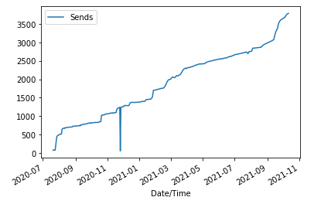
Introduction
Steadily climbing!

Slide 4
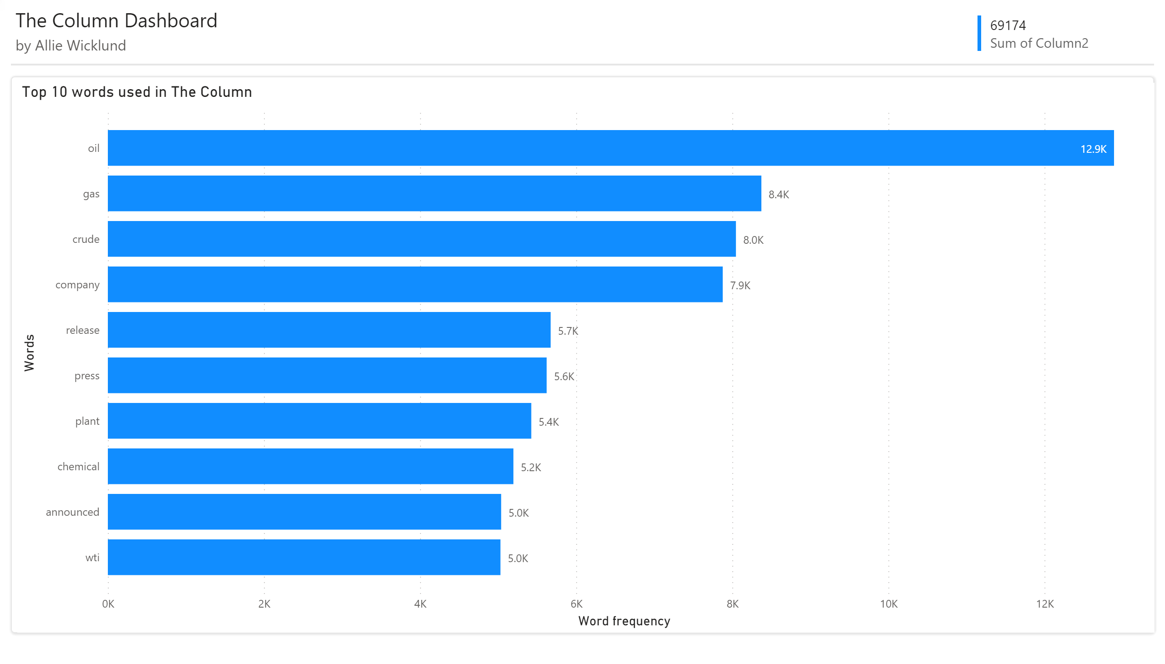
Exploring the Language

Slide 5
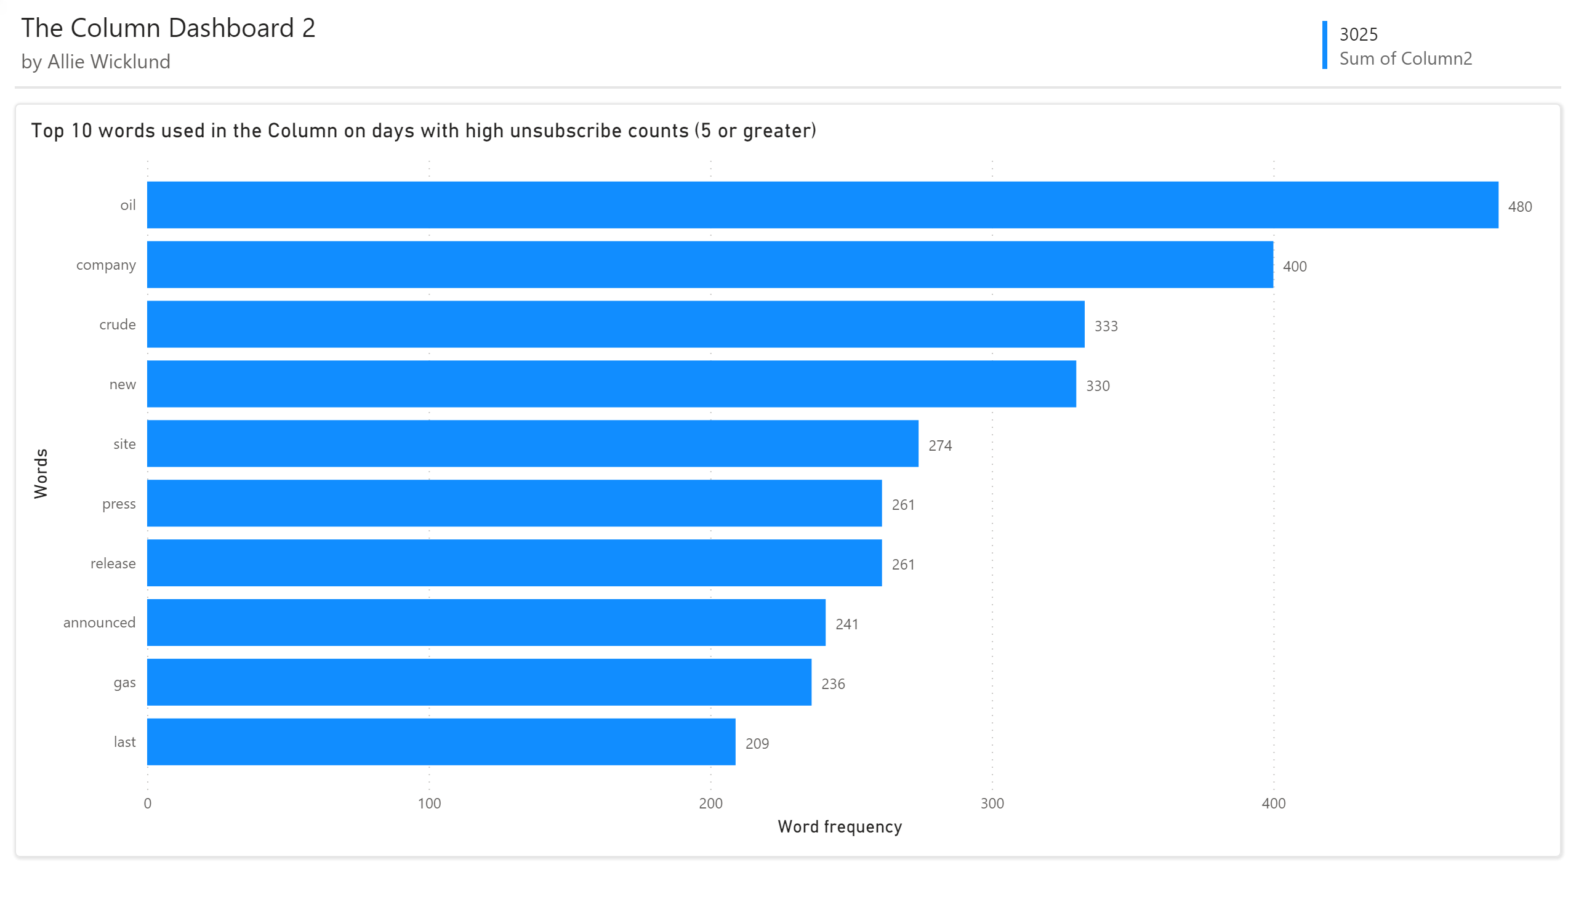
Exploring the Language
The words haven’t changed much

Slide 6
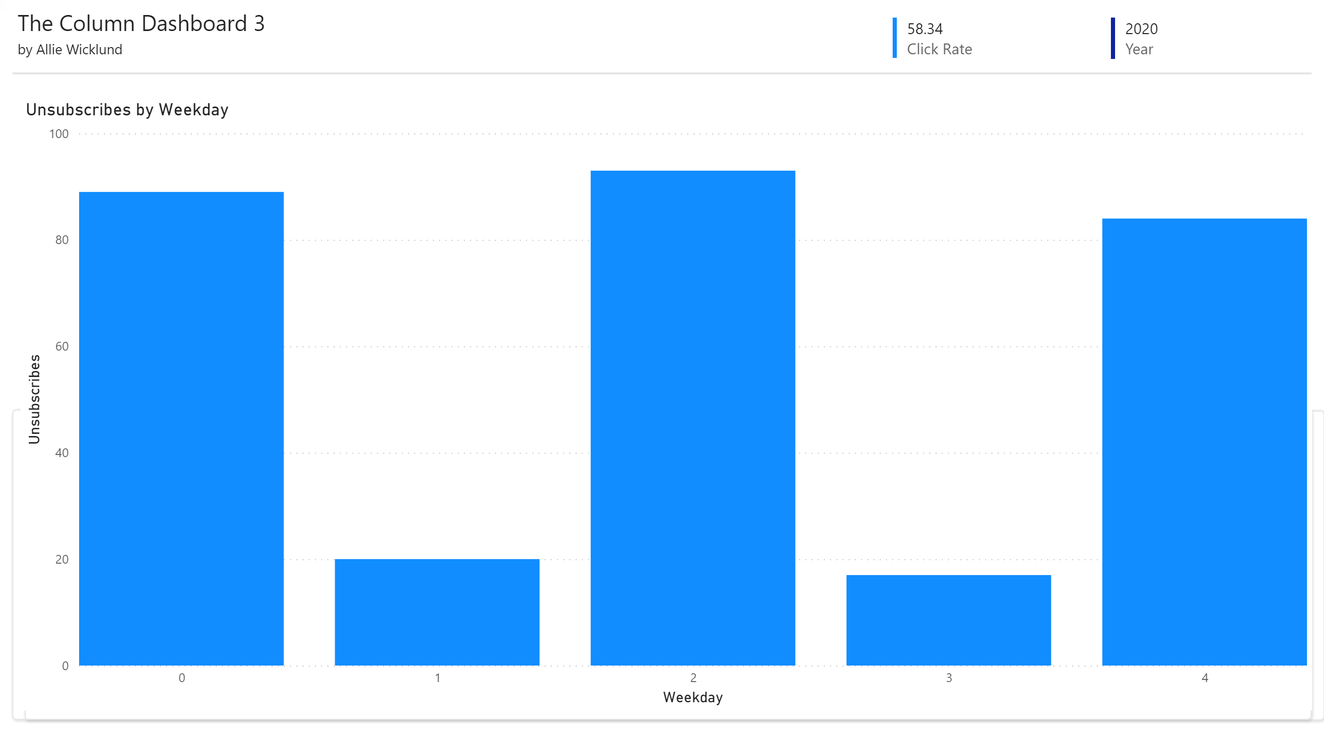
Weekday Analysis
Unsubscribes happen when sends happen.
Nothing unusual here.
M T W Th F

Slide 7
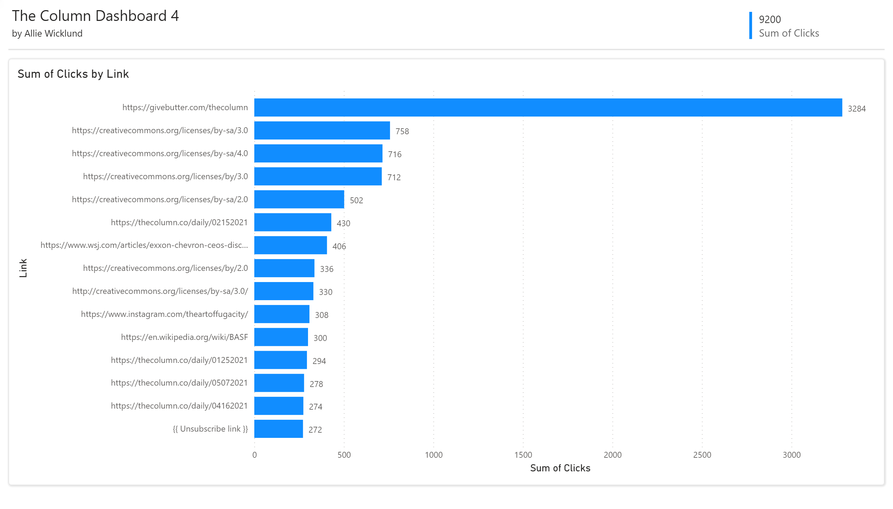
Click Counts
Donations!

Slide 8
The Solution
The Column is growing
Language is consistent
No issues with certain weekdays
Most clicks are to other The Column articles/donation
Ultimately, don’t fix what isn’t broken!

Slide 9
Unanswered Questions
Two outliers were found in the Jupyter Notebook, but why?
Why are people clicking on creative commons links?
Why does Power BI not allow for imports of excel spreadsheets?

